Slide 1
Tokenization and Indexing

Slide 2
Which plays of Shakespeare contain the words Brutus AND Caesar but NOT Calpurnia?
One could grep all of Shakespeare’s plays for Brutus and Caesar, then strip out lines containing Calpurnia?
Slow (for large corpora)
NOT Calpurnia is non-trivial
Ranked retrieval (best documents to return)

Slide 3
Term-document incidence Matrix
1 if play contains word, 0 otherwise
Brutus AND Caesar but NOT Calpurnia

Slide 4
Incidence vectors
So we have a 0/1 vector for each term.
To answer query: take the rows for Brutus, Caesar and Calpurnia (complemented) ➔ bitwise AND.
110100 AND 110111 AND 101111 = 100100.

Slide 5
Answers to query
Antony and Cleopatra, Act III, Scene ii
Agrippa [Aside to DOMITIUS ENOBARBUS]: Why, Enobarbus,
When Antony found Julius Caesar dead,
He cried almost to roaring; and he wept
When at Philippi he found Brutus slain.
Hamlet, Act III, Scene ii
Lord Polonius: I did enact Julius Caesar I was killed i' the
Capitol; Brutus killed me.

Slide 6





Search index construction
Documents to
be indexed.
Friends, Romans, countrymen.
Tokenizer
Token stream.
Friends
Romans
Countrymen
Linguistic modules
Modified tokens.
friend
roman
countryman
Indexer
friend
2
4
roman
1
2
Inverted index.
countryman
13
16

Slide 7
Tokenization
Input: “Friends, Romans and Countrymen”
Output: Tokens
Friends
Romans
and
Countrymen
Each token is candidate for an index entry, after further processing
But what are valid tokens to emit?

Slide 8
Tokenization: tricky cases
Finland’s → Finland? Finlands? Finland’s?
Hewlett-Packard → Hewlett and Packard as one or two tokens?
the hold-him-back-and-drag-him-away-maneuver ?
Numbers: unique token for every number?
L'ensemble → one token or two?
L ? L’ ? Le ?
German noun compounds are not segmented
Lebensversicherungsgesellschaftsangestellter
‘life insurance company employee’
Chinese and Japanese have no spaces between words:
莎拉波娃现在居住在美国东南部的佛罗里达。

Slide 9
Normalization
Need to “normalize” terms in indexed text as well as query terms into the same form
We want to match U.S.A. and USA
We most commonly implicitly define equivalence classes of terms
e.g., by deleting periods in a term
Alternative is to do asymmetric expansion:
Enter: window Search: window, windows
Enter: windows Search: Windows, windows
Enter: Windows Search: Windows
Potentially more powerful, but less efficient

Slide 10
Case folding
Reduce all letters to lower case
exception: upper case (in mid-sentence?)
e.g., General Motors
Fed vs. fed
SAIL vs. sail
Often best to lower case everything, since users will use lowercase regardless of ‘correct’ capitalization…
Makes some queries hard: “The Gap” – clothing store

Slide 11
Stop words
With a stop list, you exclude from dictionary entirely the commonest words. Intuition:
They have little semantic content: the, a, and, to, be
They take a lot of space: ~30% of postings for top 30
But the trend is away from doing this:
Good compression lets the space for stop words be very small
Good query optimization techniques mean you pay little at query time for including stop words.
You need them for:
Phrase queries: “King of Denmark”
Various song titles, etc.: “Let it be”, “To be or not to be”
“Relational” queries: “flights to London”

Slide 12
Stemming
Reduce terms to their “roots” before indexing
“Stemming” suggest crude affix chopping
language dependent
e.g., automate(s), automatic, automation all reduced to automat.
for example compressed
and compression are both
accepted as equivalent to
compress.
for exampl compress and
compress ar both accept
as equival to compress

Slide 13
Normalization: other languages
Accents: résumé vs. resume.
Most important criterion:
How are your users like to write their queries for these words?
Even in languages with common accents, users often may not type them
German: Tuebingen vs. Tübingen
Should be equivalent

Slide 14
Indexing

Slide 15
The problem of IR
Goal = find documents relevant to an information need from a large document set
Info. need
Query
Document
collection
IR system
Retrieval
Answer list

Slide 16
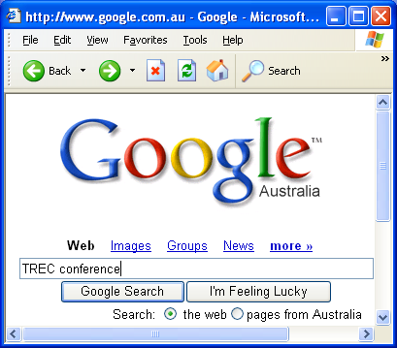
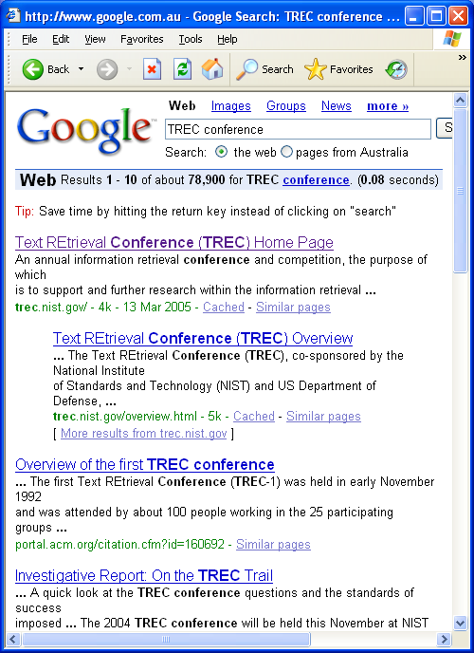
Example
Google
Web

Slide 17
Possible approaches
1. String matching (linear search in documents)
- Slow
- Difficult to improve
2. Indexing (*)
- Fast
- Flexible to further improvement

Slide 18
Indexing

Slide 19
Document indexing
Goal = Find the important meanings and create an internal representation
Factors to consider:
Accuracy to represent meanings (semantics)
Exhaustiveness (cover all the contents)
Facility for computer to manipulate
What is the best representation of contents?
Word: good coverage, not precise
Phrase: poor coverage, more precise
Concept: good coverage, precise (outliers)
Accuracy
(Precision)
Coverage
(Recall)
Word Phrase Concept

Slide 20
Parameters of retrieval effectiveness
Recall
Precision
Goal high recall and high precision

Slide 21
Big(ger) corpora
Consider N = 1M documents, each with about 1K terms.
~6 bytes/term including spaces/punctuation
6GB of data in the documents.
Say there are m = 500K distinct terms among these.
500K x 1M matrix has half-a-trillion 0’s and 1’s.
But it has no more than one billion 1’s.
matrix is extremely sparse.
What’s a better representation?
We only record the 1 positions.
Why?

Slide 22
Inverted index
The inverted index of a document collection is basically a data structure that
attaches each distinctive term with a list of all documents that contains the term.
Thus, in retrieval, it takes time to
find the documents that contains a query term.
multiple query terms are also easy to handle soon.

Slide 23
Inverted index
For each term T, we must store a list of all documents that contain T.
Do we use an array or a list for this?
Brutus
2
4
8
16
32
64
128
Calpurnia
1
2
3
5
8
13
21
34
Caesar
13
16
What happens if the word Caesar is added to document 14?

Slide 24
Inverted index
Linked lists generally preferred to arrays
Dynamic space allocation
Insertion of terms into documents easy
Space overhead of pointers
Brutus
2
4
8
16
32
64
128
Calpurnia
1
2
3
5
8
13
21
34
Caesar
13
14
16
Dictionary
Posting
Postings lists
Sorted by docID (more later on why).

Slide 25
Indexer steps
Sequence of (Modified token, Document ID) pairs.
Doc 1
Doc 2
I did enact Julius
Caesar I was killed
i' the Capitol;
Brutus killed me.
So let it be with
Caesar. The noble
Brutus hath told you
Caesar was ambitious

Slide 26
Indexer steps
Sort by terms.
Core indexing step.

Slide 27
Indexer steps
Multiple term entries in a single document are merged.
Frequency information is added.
Why frequency?
Will discuss later.

Slide 28
The result is split into a Dictionary file

Slide 29
Where do we pay in storage?
Terms
Pointers

Slide 30
Query processing: AND
Sec. 1.3
Consider processing the query:
Brutus AND Caesar
Locate Brutus in the Dictionary;
Retrieve its postings.
Locate Caesar in the Dictionary;
Retrieve its postings.
“Merge” the two postings:
2
4
8
16
32
64
128
Brutus
1
2
3
5
8
13
21
34
Caesar

Slide 31
The merge
Sec. 1.3
Walk through the two postings simultaneously, in time linear in the total number of postings entries
2
4
4
8
16
16
128
2
8
32
64
128
32
64
Brutus
2
8
1
2
5
8
13
21
34
Caesar
1
2
3
5
8
13
21
34
3
If the list lengths are x and y, the merge takes O(x+y)
operations.
Crucial: postings sorted by docID.

